Slide 1
Don't Write Secure Code! (Build secure systems instead)
Seth Petry-Johnson @spetryjohnson

Slide 2
I hate writing secure code

Slide 3
I hate writing secure code I hate writing secure features

Slide 4
I hate writing secure code I hate writing secure features I hate implementing cross-cutting security concerns by repeating the same patterns over and over again in my feature-level code

Slide 5
What's on the agenda?
Define "cross cutting" security concerns
<x> real-world examples (.NET and JS)
???

Slide 6
"Cross cutting" concern
Any security requirement that
spans multiple features

Slide 7

"Cross cutting" concerns
Security Requirements:
User must be logged in
Users with the "Manage Orders" permission see all Orders
Everyone else sees only their own Orders

Slide 8
"Cross cutting" concerns
Security Requirements:
User must be logged in
Users with the "Manage Orders" permission see all Orders
Everyone else sees only their own Orders

Slide 9
"Cross cutting" concerns

Slide 10
"Cross cutting" concerns

Slide 11
"Cross cutting" concerns

Slide 12
"Cross cutting" concerns

Slide 13
"Cross cutting" concerns

Slide 14
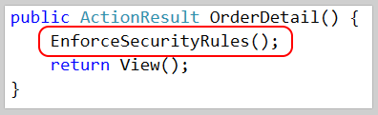
"Cross cutting" concerns

Slide 15
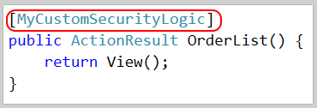
"Cross cutting" concerns

Slide 16

"Cross cutting" concerns

Slide 17
What makes a concern "cross cutting"?
Orthogonal to feature-specific business rules

Slide 18
What makes a concern "cross cutting"?
Orthogonal to feature-specific business rules
Applies to multiple features

Slide 19
What makes a concern "cross cutting"?
Orthogonal to feature-specific business rules
Applies to multiple features
Can be made "secure by default"

Slide 20
What makes a concern "cross cutting"?
Orthogonal to feature-specific business rules
Applies to multiple features
Can be made "secure by default"
Needs auditing

Slide 21
Show me the codez! bit.ly/2i0J91d

Slide 22
Cross Site Request Forgery (CSRF)

Slide 23
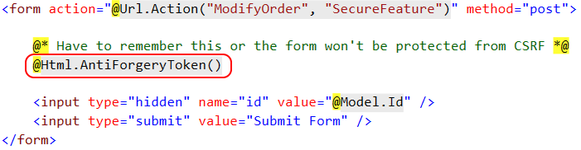
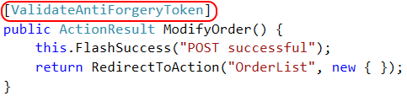
CSRF Defense – feature

Slide 24

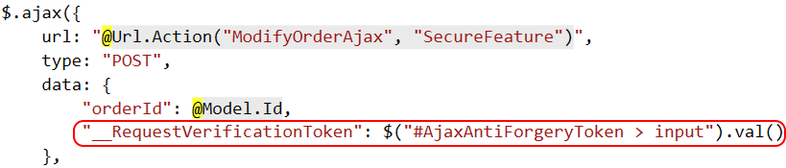
CSRF Defense – feature (ajax)

Slide 25
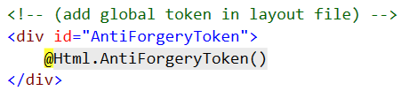
CSRF Defense – cross cutting

Slide 26
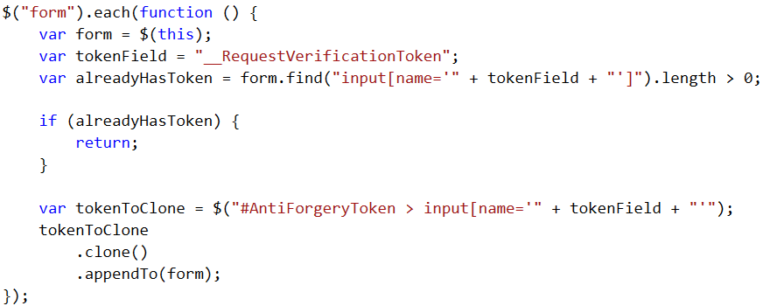
CSRF Defense – cross cutting

Slide 27
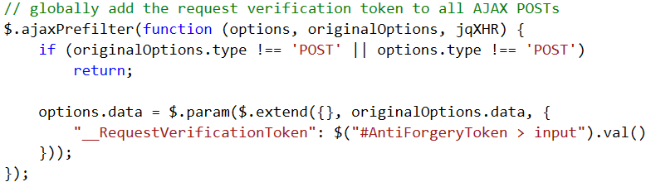
CSRF Defense – cross cutting

Slide 28
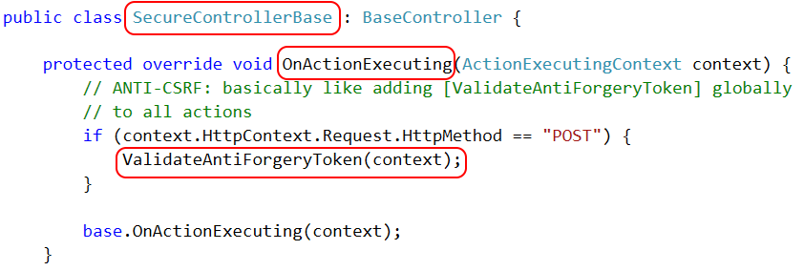
CSRF Defense – cross cutting

Slide 29

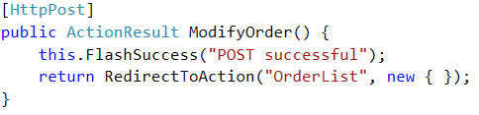
CSRF Defense – cross cutting

Slide 30
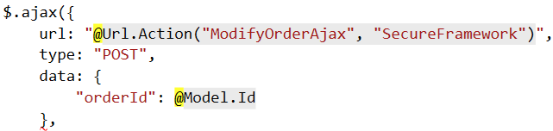
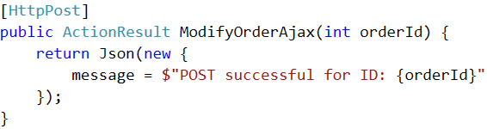
CSRF Defense – cross cutting (ajax)

Slide 31
Authorization Is user allowed to perform a given request?

Slide 32
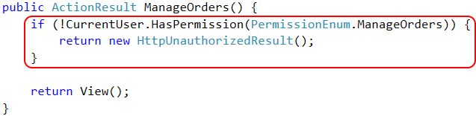
Page Authorization – feature

Slide 33

Page Authorization – cross cutting

Slide 34
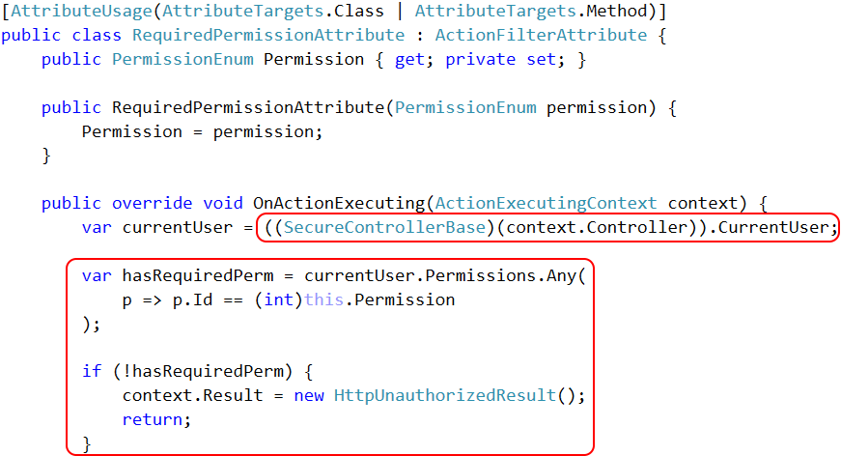

Slide 35
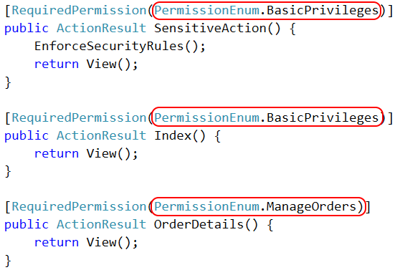
Page Authorization – auditing

Slide 36
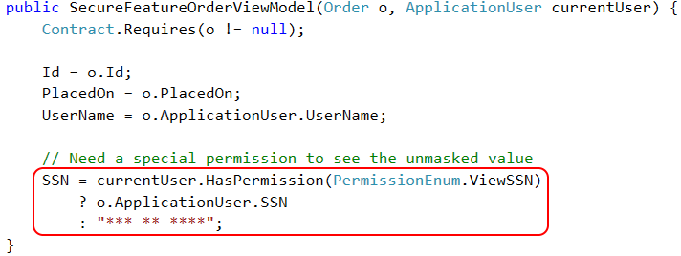
Property Authorization – feature

Slide 37
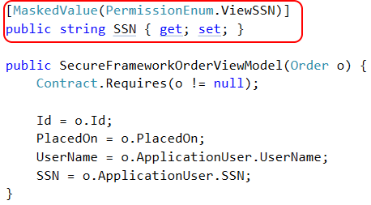
Property Authorization – cross cutting

Slide 38
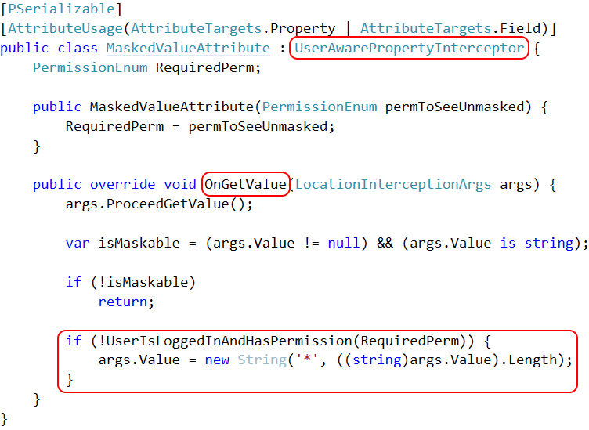

Slide 39
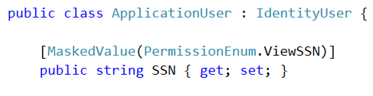
Property Authorization – cross cutting

Slide 40

Property Encryption – cross cutting

Slide 41
Access Control Keeping Bob's hands off Alice's data

Slide 42
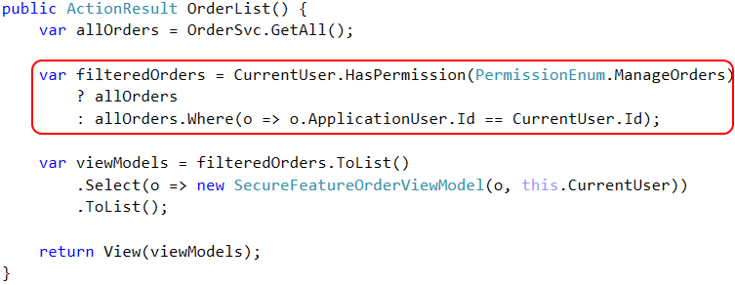
Access Control – feature

Slide 43
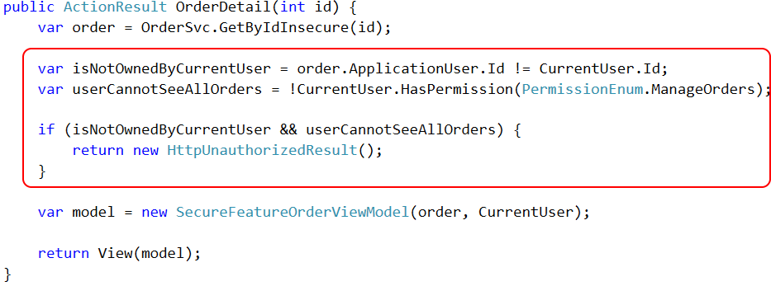
Access Control – feature

Slide 44
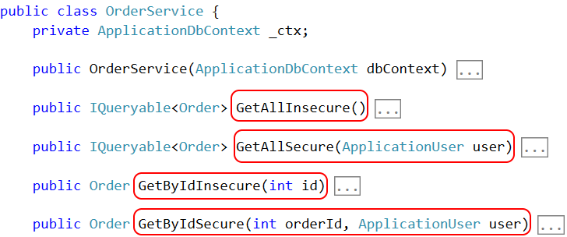
Access Control – framework

Slide 45
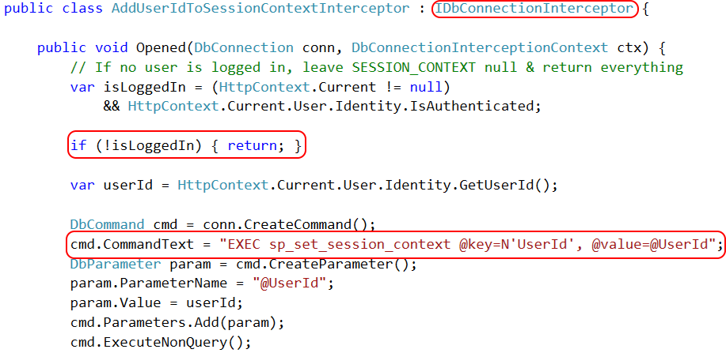
Access Control – Row Level Security

Slide 46
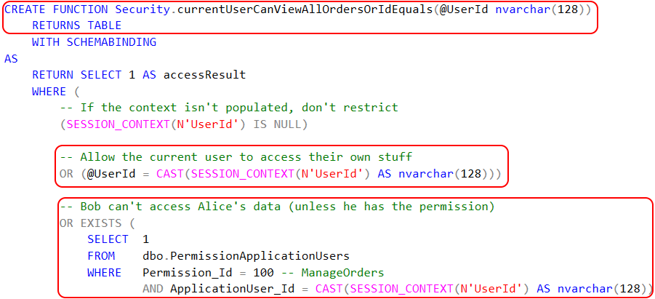
Access Control – Row Level Security

Slide 47

Access Control – Row Level Security

Slide 48
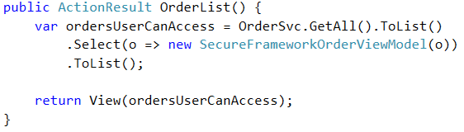
Access Control – framework

Slide 49
Patented step-by-step slide
Old news
New hotness

Slide 50
Canonical example: SQL Injection

Slide 51
Closing slide
The knowledge gets dropped here
github.com/spetryjohnson | www.petry-johnson.com
@spetryjohnson

